Slide 1
The Father of Algorithms
How Al-Khwarizmi Shaped Modern Computing

Slide 2
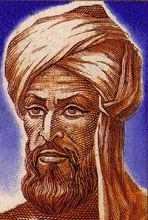
Who Was Al-Khwarizmi?
Muhammad ibn Musa al-Khwarizmi
A 9th-century Persian polymath, mathematician, astronomer, and geographer.
He was a prominent scholar at the "House of Wisdom" in Baghdad, a renowned center for learning and research during the Islamic Golden Age.
His work synthesized and expanded upon Greek, Indian, and Babylonian mathematics.
Source: Wikipedia

Slide 3




The Birth of a Word: "Algorithm"
The Name: "Algorismi"
The Concept: "Algorithm"
Al-Khwarizmi wrote a book introducing the Hindu-Arabic numeral system to the West. This book was translated into Latin.
The phrase "dixit Algorismi" ("so said Algorismi") became synonymous with following the step-by-step rules of this new arithmetic.
His name, "al-Khwarizmi," was Latinized to "Algorismi."
This evolved into the word "algorithm," meaning any systematic procedure to solve a problem.

Slide 4
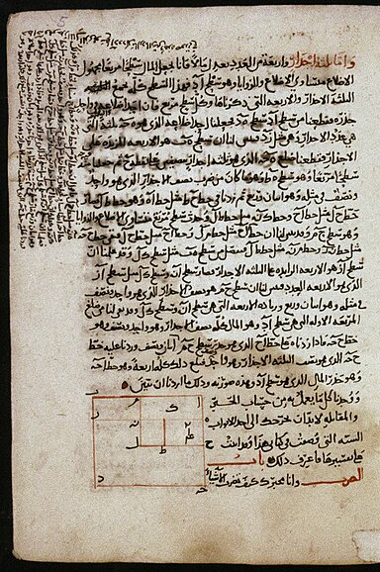
The Book That Named "Algebra"
Al-Kitāb al-mukhtaṣar fī ḥisāb al-jabr wa'l-muqābala
"The Compendious Book on Calculation by Completion and Balancing."
This is the foundational text of modern algebra. It provided a systematic way to solve linear and quadratic equations.
The word "al-jabr" (الجبر) from its title, meaning "completion" or "restoring," gave us the word **"algebra."**
Source: Wikipedia

Slide 5


The Core Concepts: "Al-Jabr" & "Al-Muqabala"
Al-Jabr (Completion)
Al-Muqabala (Balancing)
The process of "restoring" or "completing" by removing negative terms. It's the act of moving a negative quantity from one side of the equation to the other, where it becomes positive.
The process of "balancing" by subtracting the same positive quantity from both sides of the equation to simplify it.
Example: x² = 40x - 4x² ...becomes... x² + 4x² = 40x ...which simplifies to... 5x² = 40x
Example: x² + 14 = x + 5 ...becomes... x² + 14 - 5 = x + 5 - 5 ...which simplifies to... x² + 9 = x

Slide 6

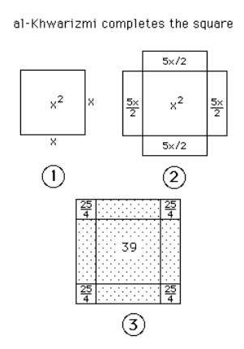
An Algorithm in Action: Solving x² + 10x = 39
Al-Khwarizmi taught how to solve equations with a repeatable, geometric procedure. He used words ("a square and 10 roots equal 39"), not symbols.
The Square: Start with a square of side 'x' (Area = x²).
The Roots: Add 10 'roots' (10x) by placing four rectangles of width 2.5 (10/4) around the square. The area is now `x² + 10x = 39`.
Complete the Square: Four small corner squares (2.5 x 2.5) are needed to form a new, larger square.
The New Area: The area of these corners is `4 * 6.25 = 25`. Add this to the original area: `39 + 25 = 64`.
Find the Side: The new square has an area of 64, so its side is `sqrt(64) = 8`.
Solve for x: This side is also `x + 2.5 + 2.5`. Therefore, `x + 5 = 8`, which means `x = 3`.
Source: mathshistory.st-andrews.ac.uk

Slide 7
A Revolution in Numbers
Al-Khwarizmi's *other* great contribution was introducing a new way to count, forever changing science, commerce, and computing.

Slide 8


A New Way to Count: Old vs. New
Old Standard
(e.g., Greek/Roman)
The New Standard
(Hindu-Arabic)
Used letters as numbers (I, V, X, L, C). 2025 → MMXXV
This system was cumbersome and difficult to use for basic arithmetic like multiplication or division.
Al-Khwarizmi's book On the Calculation with Hindu Numerals introduced this system to the world.
It was revolutionary because it included:
Critically, it lacked two key concepts:
Positional Notation:
(The "1" in 10 vs. 100)
The Number Zero (0)
Positional Value
The number Zero

Slide 9
The Power of the Positional Zero
Why It Mattered
0
The Hindu-Arabic numeral system, championed by Al-Khwarizmi, made practical arithmetic possible for the first time.
The Game Changer
Calculations that were once restricted to scholars using an abacus could now be done on paper by anyone. This is the number system we all use today, and it's the foundation of all digital computation.

Slide 10
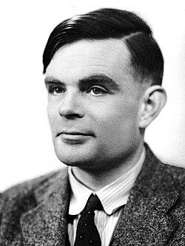
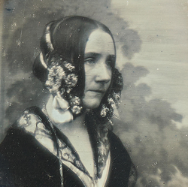
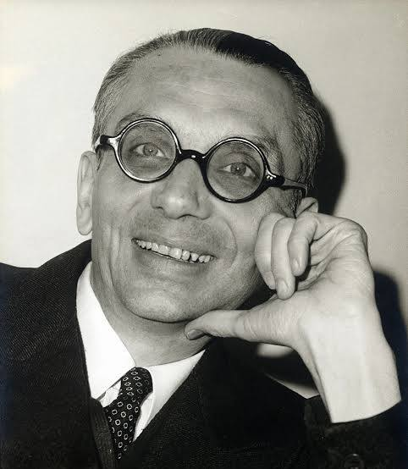
The Legacy: From Baghdad to Binary
Latin translations popularize his name ("Algorismi") as the method for arithmetic.
Every app, AI, and piece of software is built from algorithms—the legacy of Al-Khwarizmi.
12th Century
Today
9th Century
20th Century
Al-Khwarizmi defines systematic rules ("Al-Jabr") for solving problems.
Alan Turing, Gödel and others formalize the "algorithm" as the core concept of computation.
Ada Lovelace (1815 – 1852)
Pioneer of computer programming
Alan Turing (1912 – 1954)
Formulating Turing Machine
Kurt Gödel (1906 – 1978)
Algorithm Complexities

